Slide 1

Amazon Sentimental Analysis
Classification Problem:
Daily Analysis of a product such as emotions, sentiment etc. using Amazon data
Text_ID | Product_Description | Product_Type | Sentiment
Team : Pankti Rashmin Satra

Slide 2

EDA & Visualization
Sentimental Analysis
Model Building
Finalize Model based on Accuracy
Deployment

Slide 3
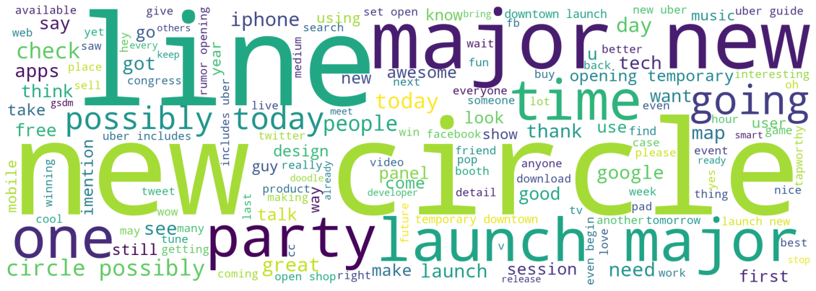
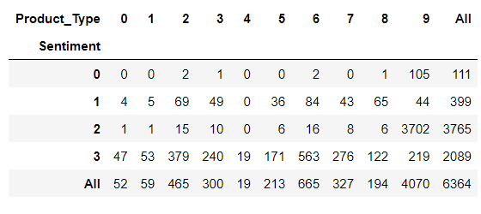
EDA & VISUALIZATION
def review_cleaning(text):
stop_words = stopwords.words('english')
stop_words.extend(["sxsw","@","rt","re","w","u","m","s","sxswi","mention","link","amp","sx","sw","wi","sxs",
"google","app","phone","pad","apple","austin","quot","android","ipad","marissa","mayer",
"social","network","store","via","popup","called","zlf","zms","quotmajorquot"])
text = normalize("NFKD", text).encode("ascii", "ignore").decode("utf-8", "ignore") # Encoding & Decoding Data
text = contractions.fix(text) #Contraction Replacement
text = re.sub("\[.*?\]","", text) #brackets
text = re.sub("https?://\S+|www\.\S+", "", text) #links
text = re.sub("<.*?>+", "", text) #characters
text = re.sub("[%s]" % re.escape(string.punctuation), "", text) #punctuations
text = re.sub("\n","", text) #new line
text = re.sub("\w*\d\w*","", text) #numbers
text = " ".join([s for s in re.split("([A-Z][a-z]+[^A-Z]*)",text) if s]) #Split attached Uppercase words
text = "".join("".join(s)[:2] for _, s in itertools.groupby(text)) #remove letter repeating twice in continuation
text = str(text).lower() #Normalization
text = " ".join(s for s in str(text).split() if s not in stop_words) #stopwords
text = " ". join([w.lemmatize() for w in TextBlob(text).words]) #Lemmatizaion
return text

Slide 4
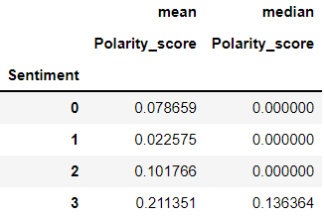
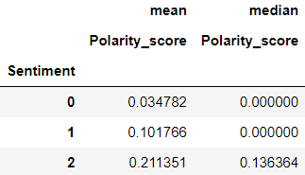
SENTIMENTAL ANALYSIS
since sentiment 0 & 1 have very few reviews and polarity scores to a similar range, we combine both of them to balance the data
amazon["Sentiment"] = amazon["Sentiment"].replace(0,1)
labelencoder = LabelEncoder()
amazon["Sentiment"] = labelencoder.fit_transform(amazon["Sentiment"])
Negative
Neutral
Positive

Slide 5
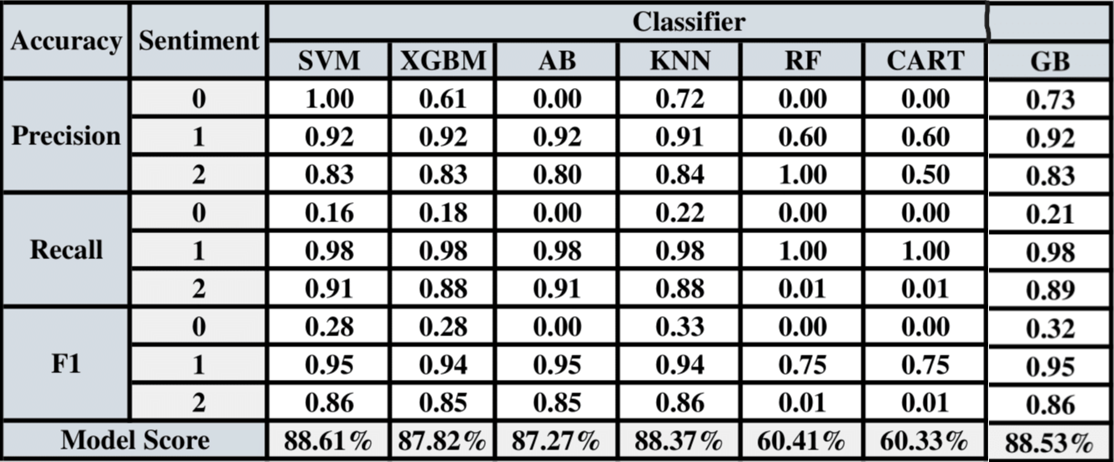
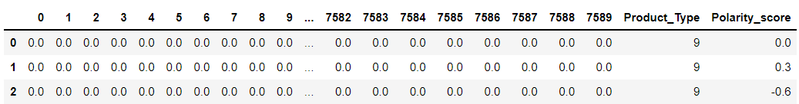
MODEL BUILDING
X = TfidfVectors, Product_Type,
Polarity_score
Shape = ( 6364, 7592 )
Y = Sentiment
Shape = ( 6364, 1 )
Trained Model using Various Classifiers like :
SVM, XG Boost, Ada Boost, KNN, Random Forest, Decision Tree,
Gradient Boosting

Slide 6

FINAL MODEL BASED ON ACCURACY
Gradient Boosting Model returns the Highest Accuracy
model = GradientBoostingClassifier()
model.fit(X,Y)
dump(model, open("Amazon.sav", "wb"))
loaded_model = load(open('Amazon.sav', 'rb'))
result = loaded_model.score(X, Y)
89.3935%
Accuracy
Classification Report -
precision recall f1-score support
0 0.73 0.21 0.32 106
1 0.92 0.98 0.95 767
2 0.83 0.89 0.86 400
accuracy 0.89 1273
macro avg 0.83 0.69 0.71 1273
weighted avg 0.88 0.89 0.87 1273

Slide 7
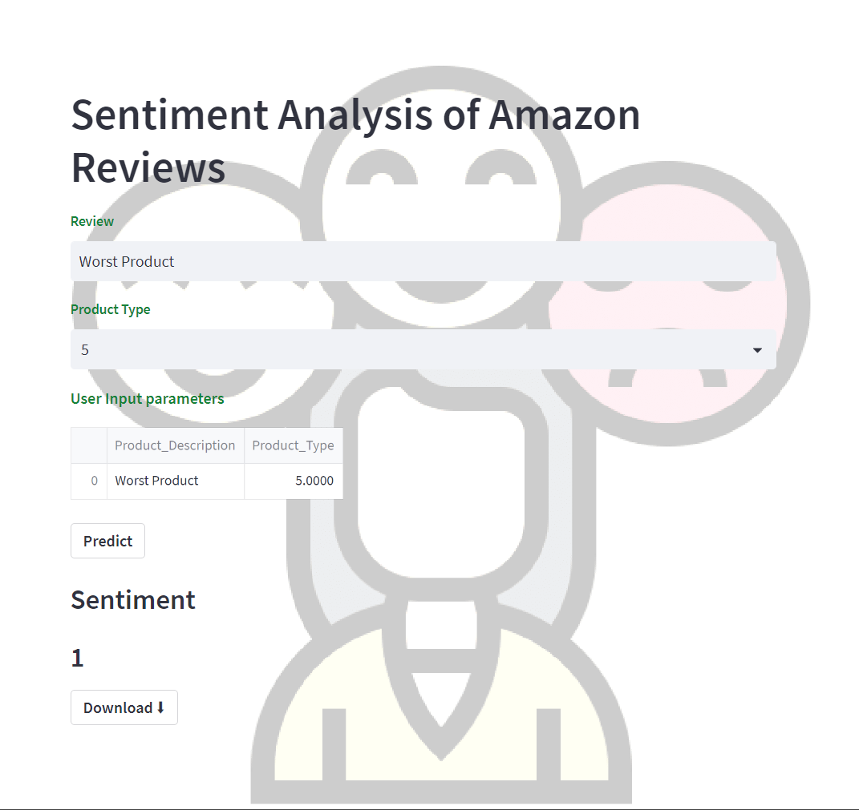
DEPLOYMENT
Deployed model on Streamlit using command prompt
Predict Button to Predict the Sentiment
Download Button to save prediction as .csv file.

Slide 8




THANK YOU

